Slide 1
Proof of Concept Proposal Lamborghini

Slide 2
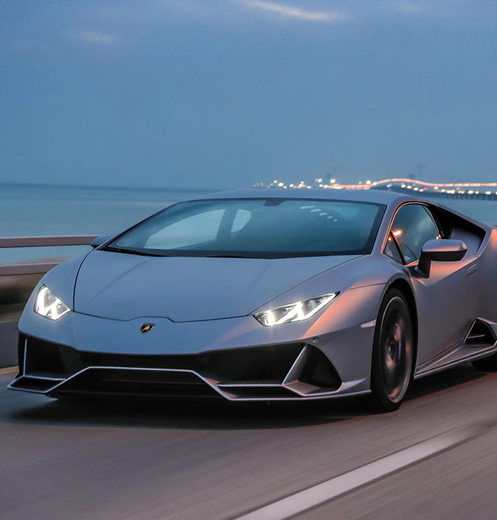
agenda
POC PROPOSALS
POC #1: Connected Car
Focus on POC #1
POC #2: Work-bench use
Focus on POC #2

Slide 3

POC #1: Connected car
In order for Lamborghini to develop a service portfolio that fully reflects users’ preferences and car usage style, we plan to make full use of the Connected Car data lake, and analyse the available data to classify Lamborgini owners on the basis of their actual driving patterns and behaviour.

Slide 4
POC #1 focus
Input Data:
Technical driving data from connected cars
Our Process:
Find usage patterns based on reference operating conditions
Develop a model to distinguish driving styles
Detect anomalies
Use driving styles and usage patterns to identify types of users
Expected Results:
Develop evidence-based user typologies
Enable Lamborgini to develop a more client oriented service portfolio

Slide 5

POC #2: Work-bench use
Improving digital asset management in the R&D phase would mean making estimating the effort needed for a project easier, allowing for less discrepancies between planning and actual needs.
Through data on the possible needs of occupancy of work-benches, we plan to develop a realistical simulation of work-bench saturation, allowing the creation of evidence-based asset management rules.

Slide 6
POC #2 focus
Input Data:
List of potential occupancy types of work-benches
Our Process:
Use a MonteCarlo Simulation to model the probability of different outcomes based on input data parameters
Develop a probabilistic model of work-bench occupancy
Expected Results:
Realistic simulation of work-bench saturation
Development of possible basis of a Digital Twin
Allowing to build asset management rules

